Slide 1

Creating a Data-Driven Organization for Southeast Airlines
Lon Kreger, David Primrose, Travis Steele, Meghan Tracy

Slide 2
Agenda
Overview/Goals
Being a “Data-Driven” Organization
Dataset Summary
Evaluation of Origin Cities
Deep Dive - Partner Airlines
Effects on NPS
Age
Status/Class
Frequent Fliers

Slide 3
Goals
What produces happy returning customers?
Understand leading indicators that influence NPS
Maximize regional partner value-add
Determine what influences airline loyalty

Slide 4
Defining - “Data-Driven”
Drive Innovation
Expand Insights
When a company employs a “data-driven” approach, it means it makes strategic decisions based on data analysis and interpretation
A data-driven approach enables companies to examine and organize their data with the goal of better serving their customers and consumers. By using data to drive its actions, an organization can contextualize and/or personalize its messaging to its prospects and customers for a more customer-centric approach
Improve Efficiency
-AT Internet

Slide 5
The Dataset
Survey data was collected from thousands of customers
We logged 86,258 responses encompassing ~30 characteristics
Derived Net Promoter Score from Likelihood to Recommend results
Grouped responses based on partner airlines to determine who may be causing customer churn
Investigated other key characteristics such as
Origin City/State
Age
Status
Class

Slide 6
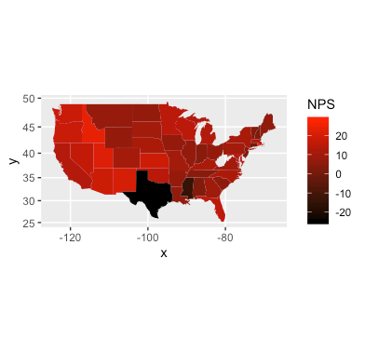
Evaluating our Origin Cities
Ranking (Worst to Best) | Departure City | Average NPS Score
1 | Hobbs, NM | -81.8
2 | Brownsville, TX | -62.5
3 | Laredo, TX | -59.1
4 | Killeen, TX | -57.6
5 | Lubbock, TX | -46.6
6 | Fort Smith, AR | -45.0
7 | Corpus Christi, TX | -44.6
Texas has the worst average NPS rating in the country at a state-wide score of -24.9
The chart to the right highlights departure cities that produce the most detractors
Texas departure cities make up 5 out of the 7 lowest cities
Evaluate airport conditions at the lowest ranked cities to determine the cause of bad “likelihood to recommend” scores

Slide 7
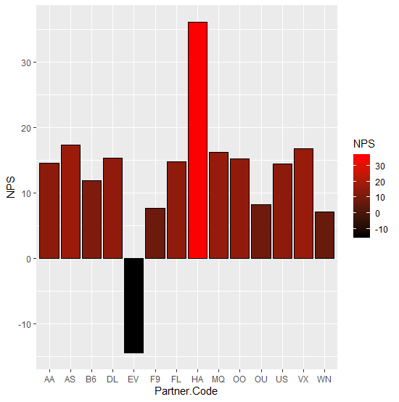
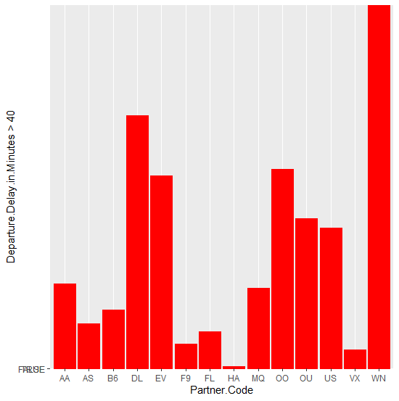
Partner Airlines
Cheapseats Airline Inc. (WN) has the most delays that are greater than 40 minutes
They are our 2nd worst partner in terms of NPS scores
We should also re-evaluate our contract with them
West Airways Inc. (HA) has the fewest delays
Likely a reason for their high NPS score
FlyFast Airways Inc. (EV) has a the lowest NPS score and we should consider discontinuing partnering with them
Eliminating FlyFast would drive our NPS score up to 12.3 from 9.3
West Airways Inc. (HA) has the highest NPS score
How can we emulate what they are doing to drive up our NPS score?
Notes:
# Partner.Name Partner.Code count
#1 Paul Smith Airlines Inc. AA 4573
#2 FlyToSun Airlines Inc. AS 2540
#3 OnlyJets Airlines Inc. B6 3088
#4 Sigma Airlines Inc. DL 13675
#5 FlyFast Airways Inc. EV 10055
#6 GoingNorth Airlines Inc. F9 1283
#7 FlyHere Airways FL 2034
#8 West Airways Inc. HA 116
#9 EnjoyFlying Air Services MQ 4274
#10 Northwest Business Airlines Inc. OO 10704
#11 Oursin Airlines Inc. OU 7975
#12 Southeast Airlines Co. US 7767
#13 Cool&Young Airlines Inc. VX 1026
#14 Cheapseats Airlines Inc. WN 18990

Slide 8
Effect of Age on NPS
NPS tends to be higher with customers between the ages of 20 and 60
There is significant deterioration in likelihood to recommend scores as age increases
With an aging population that’s increasing (boomers), steps need to be taken to improve their experience with us
Evaluate policies for unaccompanied minors and the elderly to ensure we’re paying attention to their health & overall needs

Slide 9
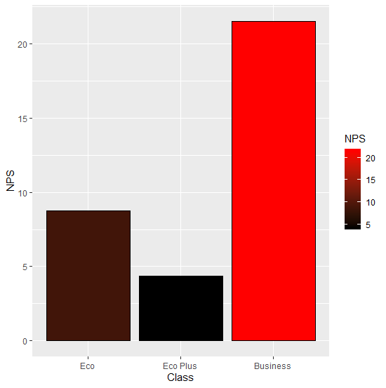
Class Warfare
As would be expected, our passengers seated in business class have a high likelihood to recommend our airline.
What becomes less intuitive is our Economy Plus NPS score is significantly lower than those seated in Economy
Recommended Approach:
- Focus group needed to identify the perceived lack of value for customers riding in Economy Plus
Are they getting enough value for the price they’re paying?
What is included that differentiates Eco + Eco Plus?

Slide 10
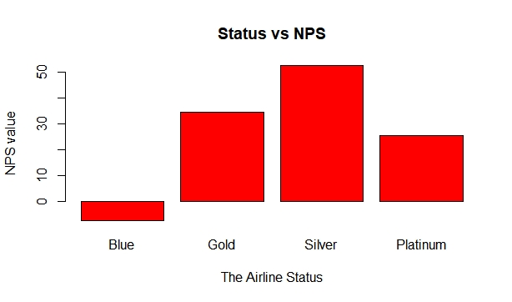
Loyalty Status & NPS
A brief glance at this bar chart tells us that we have work to do. Perhaps our two most import customer segments to have a high likelihood to recommend would be
Our Platinum members who have demonstrated high levels of loyalty for many years
Newly acquired customers who are difficult to obtain in a competitive market
Recommended Approach:
Start with a comprehensive review on our benefit offering compared to industry leaders.
Additional research needed to uncover specific “Platinum” and “Blue” customer dissatisfaction issues

Slide 11
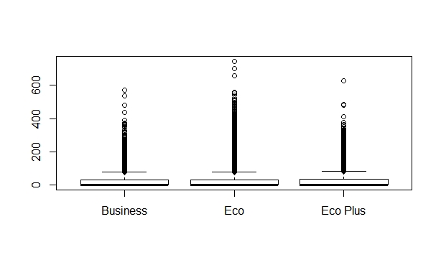
Airport Shoppers and the Tickets they Buy
Economy class ticket holders show a slightly higher propensity for airport purchases.
While this may seem slightly surprising at first, some logical analysis tells us that perhaps because these fliers are novices, they are more likely to have forgotten items for their trip requiring purchases last minute. Additionally, the Business class traveler often heads straight to the loyalty lounges to enjoy the free amenities there.
Recommended Approach:
Find opportunities to encourage our eco/eco plus ticket holder's to continue their propensity to shop
Potential for increased joint marketing opportunities with airport stores

Slide 12
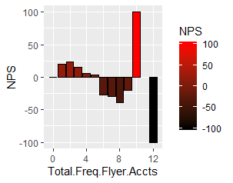
Frequent Flier Accounts
# of Frequent Flier Accounts | # of Customers
0 | 45334
1 | 16830
2 | 15652
3 | 5997
4 | 1782
5 | 448
6 | 138
7 | 50
8 | 18
9 | 5
10 | 3
12 | 1
Per the data, an increased number of frequent flier accounts decreases customers Likelihood to Recommend scores.
Determine cause of downward trend
Could this be due to low loyalty with a singular airline?
Customers with 10 accounts have an alarmingly high NPS vs. customers that have 12 drop to extremely low NPS number.
These are outliers (not the trend) in the data so should be disregarded
*Please note that per our sampling, no customer appears to have 11 frequent flyer accounts

Slide 13
Linear Regression Modeling
R squared is a measure that explains how much of your dependent variable (Likelihood to represent) is affected by your input variables (Class, Airline Status, Gender, etc.)
After running regression models on our input variables, we discovered no individual attributes impacted results more than 10%
By combining variables such as age, airline status & flights per year, we were able to find a ~17% impact on Likelihood to Recommend scores

Slide 14
Support Vector Machine (SVM)
Confusion Matrix and Statistics
Prediction FALSE TRUE
FALSE 50687 17968
TRUE 4127 4849
Accuracy : 0.7154
95% CI : (0.7122, 0.7186)
No Information Rate : 0.7061
P-Value [Acc > NIR] : 5.934e-09
Kappa : 0.1667
We found combination of Airline Status and Flights Per Year affect our output (Likelihood to Recommend score) by ~16% on a linear model basis
SVM is a machine learning algorithm which tries to make predictions based on our past data
It creates classifications of our data
The model predicted 71.5% of the time whether a person would be a detractor based on the Airline Status and Flights per Year input

Slide 15
Questions?

